Slide 1
Advanced Regression Techniques To Predict Housing Prices
By
Daniel Bradley, Nate Berman and Peter Shapiro

Slide 2
The Business Problem
Buying the right house is a difficult decision and important investment
What factors have the greatest impact on the price
We wanted to create a tool to help home buyers identify undervalued homes in the marketplace

Slide 3
Current State
People rely on the following for information for guidance:
Real Estate Agents- Might not have your best interest in mind
Homes In Close Proximity- This will have some effect, but might not be the difference making factor
Information Online- Can sometime be misleading

Slide 4
Home Equity
“The difference between how much you owe on your mortgage and the market price or value of your home”- JIM PROBASCO
Being able to find a home that is underpriced can help to improve the rate at which you are able to build equity
Minimum Performance Measure Needed, How to measure performance
https://www.investopedia.com/articles/mortgages-real-estate/08/home-ownership.asp

Slide 5
Frame The Problem
Supervised learning task-
We know the outcome ( each instance comes with house prices)
01
Multiple Regression-
Multiple attributes/features- uses multiple features to make the prediction
02
Univariate Regression-
We are only trying to predict one outcome
03
Batch learning because it is small enough to fit into local memory
04

Slide 6
The Data
Kaggle DataSet(https://www.kaggle.com/c/house-prices-advanced-regression-techniques/data)
1,460 homes in Ames, Iowa
79 explanatory variables for almost every home
Categorical and numerical data features

Slide 7
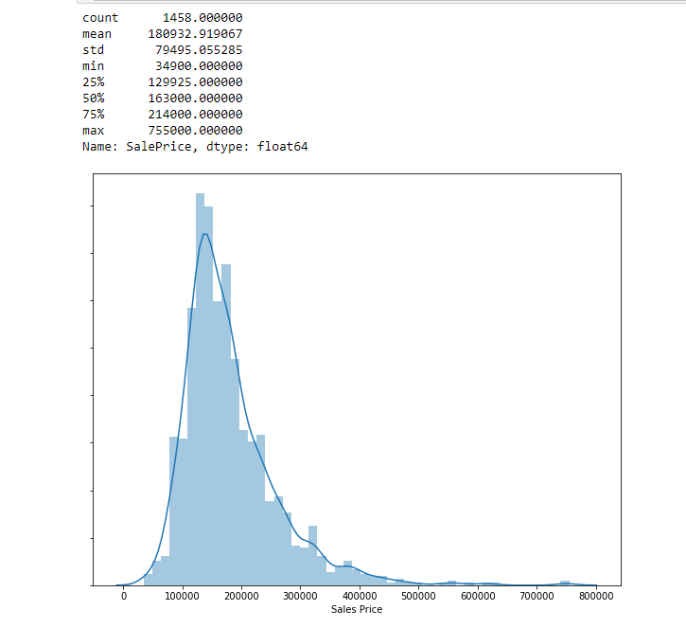
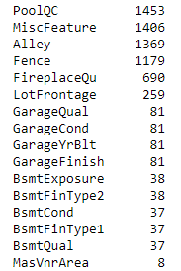
Exploring The Data
Null Values

Slide 8
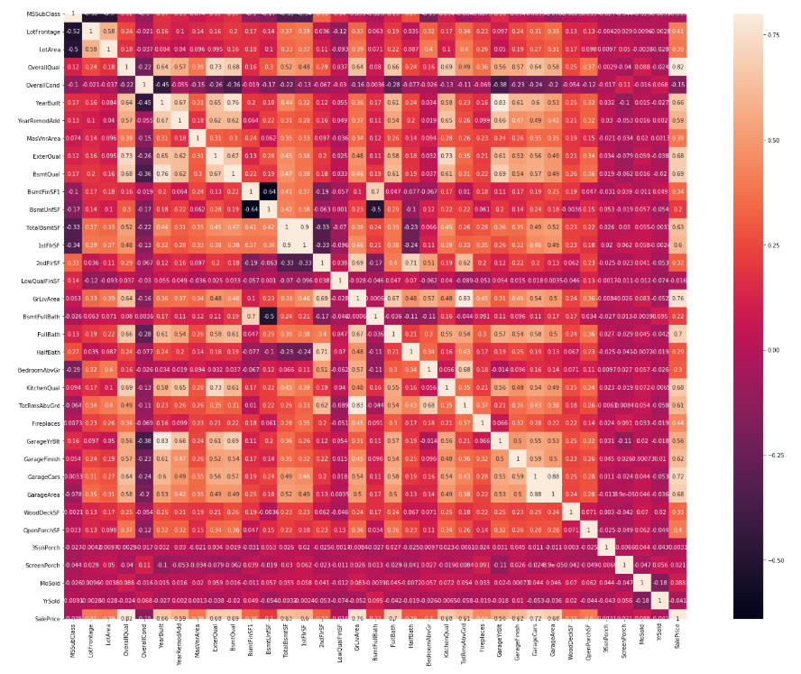
Exploring The Data

Slide 9
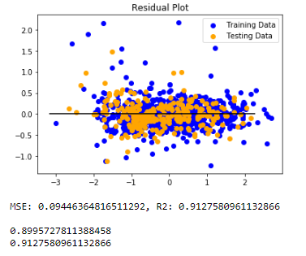
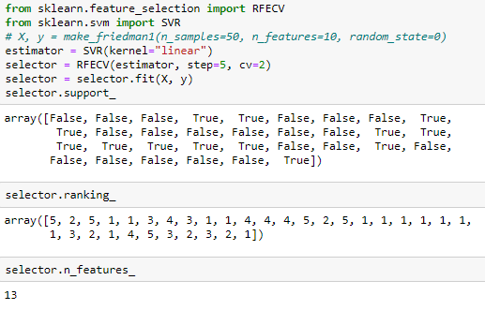
Standard Linear Regression
Able to get 92% accuracy out of the model
However this required a large number of features

Slide 10
Standard Linear Regression
Recursive feature elimination revealed that this model may have had too many features included in it for its prediction

Slide 11
Nate

Slide 12
Daniel

